Slide 1
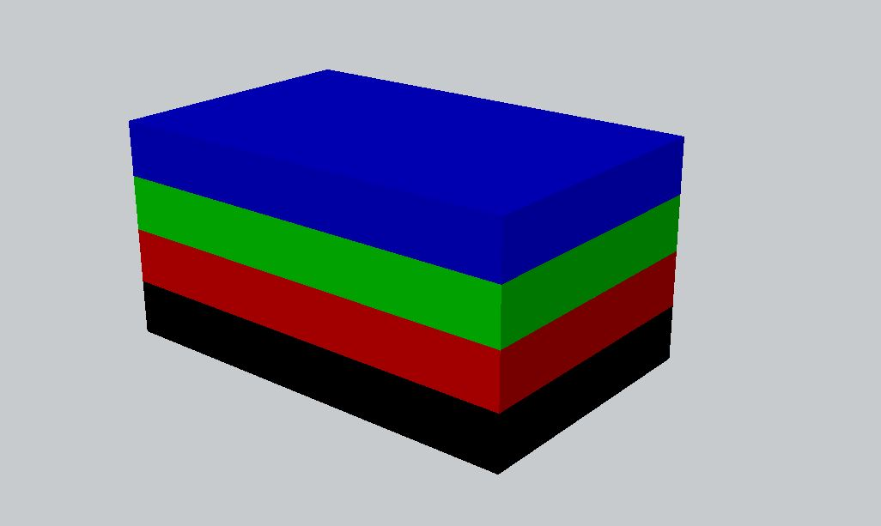
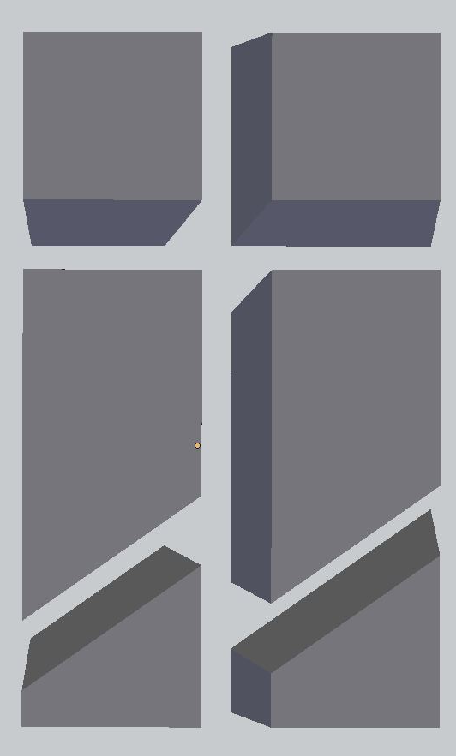
C 3:
1894
C 0:
2253
C 4:
2598
C 1:
2859
C 5:
1194
C 2:
1552
(A) Tall Box Rotated Layers
(B) Chunk Configuration
Layers 0-3

